Slide 1
Introduction to GitHub Actions
Module 5 – Deploying to the Cloud

Slide 2
Continuous integration (CI) and continuous delivery /deployment (CD) are methods for automating the processes involved in testing and deploying new code
Performing these tasks automatically as opposed to manually saves a lot of time and allows for quicker deployments and more stable builds
CI/CD has become so important that a wide range of tools exist to facilitate these automated workflows
Many repository-hosting services and cloud providers offer their own suites of CI/CD tools
One such tool offered by GitHub is GitHub Actions
Recap – CI/CD

Slide 3
GitHub Actions may be enabled on any GitHub repository in order to implement CI/CD for that project
When Actions is enabled on a repository it will, on pre-defined triggers, execute the steps laid out in one or more workflows
these are defined in a directory within the repository called .github/workflows
A workflow can be broken down further into jobs and then steps
Each time a workflow is triggered, the resulting execution is called a run
Actions executes the tasks making up the workflow in containers – each job gets its’ own container which defines the build environment
Essential concepts

Slide 4
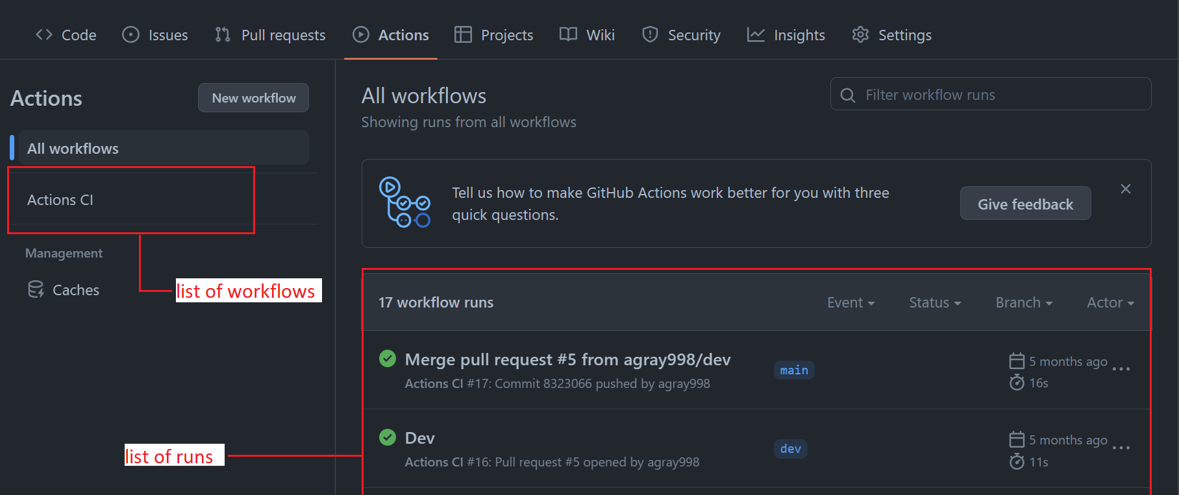
UI example – workflows

Slide 5
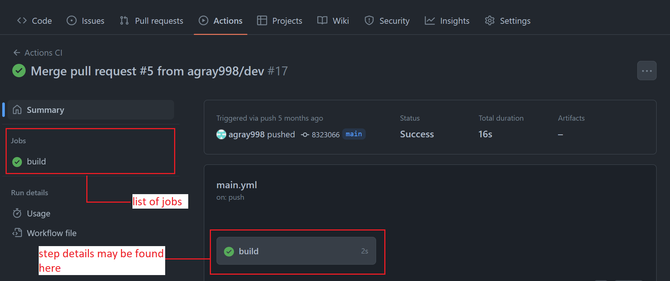
UI example – jobs

Slide 6
Discussion: why GitHub actions?
In breakout groups, think about how GitHub Actions compares to other common CI/CD tools – e.g., Jenkins, TeamCity, CircleCI – and consider the following questions:
Do you notice any common patterns in how these tools are used?
What might be the pros and cons of GitHub actions, in comparison with these other tools?

Slide 7
Broadly speaking, CI/CD tools may be self-hosted (e.g., Jenkins server, TeamCity server) or managed (e.g., GitHub Actions, CircleCI)
Managed CI/CD tools offer a cost reduction – you do not need to incur the costs of maintaining a server, and are typically only billed for the time that your jobs are running
Managed CI/CD tools are also highly scalable – it is easy to spin up more containers to handle increased workloads
Self-hosted servers can offer more customisability, useful if a somewhat niche configuration is required for your build environment
Compared to other managed services, GitHub Actions offers extensive integration with other tools and services, including major cloud platforms
GitHub automatically runs workflows defined in GitHub repositories – if your repository is not hosted on GitHub then you may want to use an alternative service
Why GitHub Actions?

Slide 8
Workflows are specified using a syntax called YAML – if you’re not familiar with YAML think of it as JSON without the curly braces
The workflow begins with a name, which sets the name of the workflow as it will appear when viewing the runs for that workflow
The on section sets the triggers for the workflow – these are grouped by event type, with a list of branches for which each event should trigger a run
The jobs section contains one or more jobs, each of which should define the runner which will execute that job, and the steps of which the job is comprised
Workflows may also include an env section, which sets environment variables for use during the run
Workflow structure

Slide 9
name: example workflow
on:
push:
branches: [“dev”]
pull_request:
branches: [“main”]
workflow_dispatch:
jobs:
example_job:
runs-on: ubuntu-latest
steps:
- uses: actions/checkout@v3
- name: example step
run: echo “Hello World”
Basic
Workflow

Slide 10
From the main page of a GitHub repository, Actions can be enabled via the Actions tab
If actions is not already enabled, the actions tab will provide templates for setting up workflows
Among the provided templates are suggested templates based on the language(s) detected in the repository
Various templates are also available for deploying to various cloud platforms
If you want to start from scratch, a simple Hello World template is also available
When you add a workflow, the .github/workflows directory will be created automatically
Configuring Actions

Slide 11
The YAML file defining a workflow is stored in the repository, and may be modified as with any other file
This allows you to modify templates to customise them to your needs, and update the CI as a project evolves
To add functionality to a workflow, a variety of runners and modules are available to give access to specific functionality
Alternately, for simple jobs, you can use a basic ubuntu runner and create a shell script which defines the necessary steps
Custom Workflows

Slide 12
Exercise 2: setting up actions
Enable Actions on an existing GitHub repository
Update the workflow to run automated tests for your code

Slide 13
Recall that each job within a workflow gets its' own runner – a container which is spun up to execute the steps of that job
GitHub provides hosted runners for Windows, MacOS and Ubuntu – these have a range of preinstalled software that can be used during runs
The documentation for Actions has a comprehensive list of the software installed on each of these runners
If you need a very specific build environment, and want to save time configuring the default runners for each build, you can self-host runners
Self-hosted runners require more effort to set up than GitHub-hosted, but allow you to use custom container images with the exact build environment you need
Runners

Slide 14
In addition to running shell scripts, GitHub Actions has a range of modules – these are the 'Actions' in 'GitHub Actions' - available for use as part of jobs
There are a variety of actions available from GitHub, under the actions namespace, and many more third-party actions which offer a range of functionality
Actions are invoked via the 'uses' key. The action is referenced as 'namespace/action@version'
Many actions require inputs to be given, these are provided via a 'with' mapping following the invocation
If needed, it is possible to create and publish your own custom actions by writing a node application with the desired functionality, and an 'action.yml' file which defines usage details
Modules

Slide 15
GitHub Actions is a managed, container-based service for implementing scalable, cost-effective CI on GitHub repositories
Actions executes workflows, themselves subdivided into jobs which are in turn comprised of steps
Workflows are defined by YAML files which specify the details of the workflow via a set of key-value pairs
A wide range of YAML templates are provided as starting points, which can then be customised to your own needs
Modules, called actions, offered by GitHub and by third-parties provide extended functionality
Review

Slide 16
End of section

